Slide 1
Chapter 26
SMTP
and
FTP
In this chapter we’ll discuss two popular applications for exchanging information.
Electronic Mail: Exchanges information between people.
File Transfer. Exchanges files between computers.

Slide 2
26.1 Electronic Mail
Sending/Receiving Mail
Addresses
User Agent
MIME
Mail Transfer Agent
Mail Access Protocols

Slide 3
26.1 Electronic Mail
Electronic mail or email is one of the most popular network service.
Electronic mail is used for sending a single messages that includes:
    Text,
    Voice,
    Video or
    Graphics
To one or more recipients.
Simple Mail Transfer Protocol (SMTP) is standard mechanism for electronic mail in Internet.

Slide 4
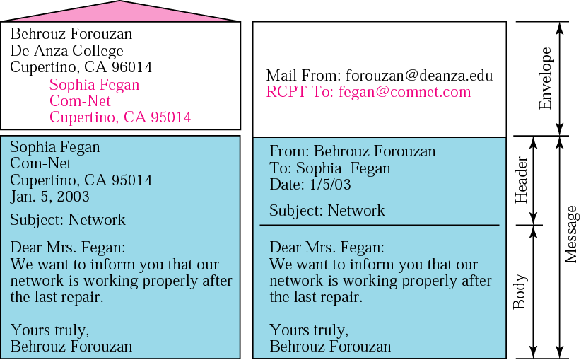
26.1 Electronic Mail → Sending/Receiving Mail → Sending Mail:
Figure 26.1 Format of an email
To send mail, the user creates mail that looks very similar to postal mail.
It has an envelope and a message as shown in Fig. 26.1 below:

Slide 5
26.1 Electronic Mail → Sending/Receiving Mail → Sending Mail:
Envelop:
The envelop usually contains the sender address, the receiver address and other information.
Message:
The message contains the headers and the body part.
The headers of the message defines the sender, the receiver, the subject of the message and other information.
The body of the message contains the actual information to be read by the recipient.

Slide 6
26.1 Electronic Mail → Sending/Receiving Mail → Receiving Mail:
The email system periodically checks the mailboxes.
If a user has mail, it inform the user with a notice.
If the user is ready to read the mail, a list displayed in which each line contains a summary of the information about a particular message in the mailbox.
The summary usually includes:
    The sender mail address,
    The subject,
    And the time the mail was sent or received.
The user can select any of the message and display its contents on the screen.

Slide 7
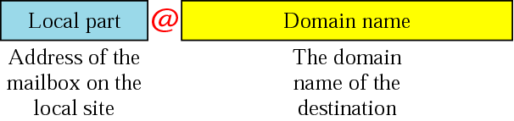
26.1 Electronic Mail → Addresses:
Figure 26.2 Email address
To deliver mail, a mail handling system must use an addressing system with unique addresses.
The addressing system used by SMTP consists of two parts:
    A local part and
    A domain name.
Separated by an @ sign, as shown in Fig. 26.2 below:

Slide 8
26.1 Electronic Mail → Addresses:
Local Part:
The local part defines the name of a special file, called the user mailbox, where all the mail received for a user, is stored for retrieval by the user agent.
Domain Name:
The second part of the address is the domain name.
An organization usually selects one or more hosts to receive and send email; they are sometimes called mail exchanges.
The domain name assigned to each mail exchanger either comes from the DNS database or is logical name (e.g., the name of the organization).

Slide 9
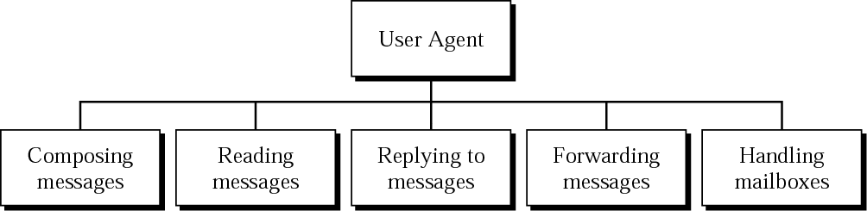
26.1 Electronic Mail → User Agent (UA):
Figure 26.3 User agent
User Agent (UA) is the first component of Electronic Mail system.
A User Agent is sometimes called a mail reader, but this terminology is confusing, so we prefer to use the term User Agent.
Services Provided by a User Agent:
A User Agent is a software package (program) that
    Composes,
    Reads,
    Replies to and
    Forward messages.
It also handles mail boxes.
Fig. 26.3 below shows the services of a typical user agent.

Slide 10
26.1 Electronic Mail → User Agent (UA):
Figure 26.3 User agent
User Agent (UA) is the first component of Electronic Mail system.
A User Agent is sometimes called a mail reader, but this terminology is confusing, so we prefer to use the term User Agent.
Services Provided by a User Agent:
A User Agent is a software package (program) that
    Composes,
    Reads,
    Replies to and
    Forward messages.
It also handles mail boxes.
Fig. 26.3 below shows the services of a typical user agent.

Slide 11
26.1 Electronic Mail → User Agent (UA) → Services Provided By a User Agent:
Composing Messages:
A User Agent is responsible for composing the email message to be sent out.
Most user agents provide a template on the screen to be filled in by the user.
Some even has a built-in editor that can do:
    Spell checking,
    Grammar checking, and
    other tasks one expects from a sophisticated word processor.
A user, off course, can use his or her favorite text editor or word processor to create the message and import it, or cut and paste, into the user agent.

Slide 12
26.1 Electronic Mail → User Agent (UA) → Services Provided By a User Agent:
Reading Messages:
The second duty of the user agent is to read the incoming messages.
When a user invokes a user agent, it first checks the mail in the incoming mailbox.
Most user agents show a one-line summary of each retrieval mail which contain the following fields:
    A number field,
    A flag field that shows if
        the mail is new,
        already read but not replied to,
        read and replied,
        and so on.
    The size of the message,
    The sender,
    The subject field if the subject line in the message Is not empty.

Slide 13
26.1 Electronic Mail → User Agent (UA) → Services Provided By a User Agent:
Replying to Messages:
After reading a message, a user can use the user agent to reply to a message.
Normally, a user agent allows the user to reply to the original sender or to reply to all recipients of the message.
The reply message normally contains the original message (for quick reference) and the new message.
Forwarding Message:
Replying is defined as sending a message to the sender or recipients of the copy.
Forwarding means to send the message to a third party.
A user agent allows the receiver to forward the message, with or without extra comments, to a third party.

Slide 14
26.1 Electronic Mail → User Agent (UA) → Services Provided By a User Agent:
Handling Mailboxes:
A user agent creates two mailboxes:
    Inbox and
    Outbox.
Each box is a file with special format that can be handled by the user agent.
The inbox keeps all the received emails until they are deleted by the user.
The outbox keeps all the sent emails until the user deletes them.

Slide 15
26.1 Electronic Mail → User Agent (UA) → User Agent Types:
There are two types of user agents:
      Command-driven and
      GUI based.
Command Driven:
Command-driven user agents belong to the early days of the electronic mail.
They are still present as the underlying user agents in servers.
A command-driven user agent normally accepts a one-character command from the keyboard to perform its task.
E.g. A user can type the character r, at the command prompt, to reply to the sender of the message.
Or type R to reply to sender and all recipient.
Some examples of command-driven user agents are:
Mail,
Pine, and
Elm.

Slide 16

Note:
Some examples of command-driven user agents are mail, pine, and elm.

Slide 17
26.1 Electronic Mail → User Agent (UA) → User Agent Types:
GUI Based:
Modern user agents are GUI-based.
They contain graphical user interface (GUI) components that allow the user to interact with the software by using both the keyboard and the mouse.
They have graphical components such as
    Icons,
    Menu bars and
    Windows
    that make the services easy access.
Some examples of GUI-based user agents are:
Eudora,
Microsoft’s Outlook and
Netscape.

Slide 18
Note:
Some examples of GUI-based user agents are Eudora, Outlook, and Netscape.

Slide 19
26.1 Electronic Mail → MIME:
Multipurpose Internet Mail Extensions:
SMPTP is a simple mail transfer protocol.
Its simplicity, however comes with a price.
SMTP has some limitations e.g.
  SMTP can send messages only in 7-bit ASCII format.
  SMTP cannot be used for languages that are not supported by 7-bit ASCII characters (such as French, German, Russian Chinese and Japanese).
  SMTP cannot be used to send binary files (files that are stored as stream of 0s and 1s without using any character code), video and audio.
MIME is a supplementary protocol that allows non-ASCII data to be sent through SMTP.
MIME is not a mail protocol and cannot replace SMTP.
MIME is only an extension to SMTP.

Slide 20
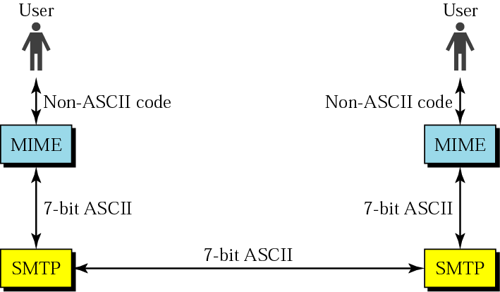
26.1 Electronic Mail → MIME:
Figure 26.4 MIME
MIME transforms non-ASCII data at the sender site ASCII data and delivers to the client SMTP to be sent through the Internet.
The server SMTP at the receiving side receives the ASCII data and delivers them to MIME to be transformed to the original data.
We can think of MIME as a set of software functions that transforms non-ASCII data to ASCII data and vice versa, as shown in Fig. 26.4 below:

Slide 21
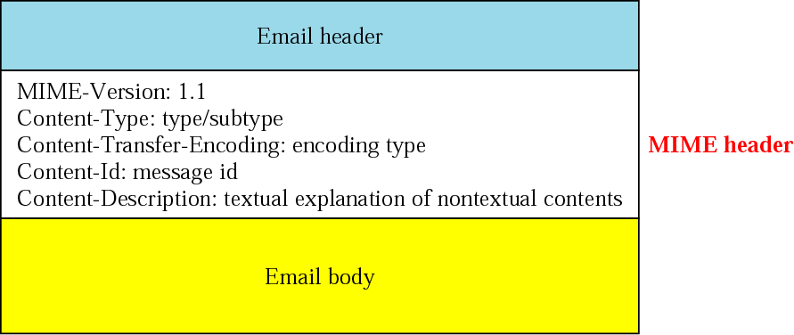
26.1 Electronic Mail → MIME:
Figure 26.5 MIME header
MIME defines five headers that can be added to the original SMTP header section to define the transformation parameters:
    MIME-Version.
    Content-Type.
    Content-Transfer-Encoding.
    Content-Id.
    Content-Description.
Fig. 26.5 below shows the original header and the extended header.

Slide 22
26.1 Electronic Mail → MIME → Header Fields:
MIME-Version:
This header defines the version of MIME used.
The current version is 1.1.
MIME-Version: 1.1.
Content-Type:
This header defines the type of data used in the body of the message.
The content-type and the content-subtype are separated by a slash.
Depending on the subtype, the header may contain other parameters.
Content-Type: <Type / subtype; parameters >

Slide 23
Table 26.1 Data types and subtypes in MIME
Type | Subtype | Description
Text | Plain | Unformatted text
Multiport | Mixed | Body contains ordered parts of different data types
 | Parallel | Same as above, but no order
 | Digest | Similar to mixed, but the default is message/RFC822
 | Alternative | Parts are different versions of the same message
Message | RFC822 | Body is an encapsulated message
 | Partial | Body is a fragment of a bigger message
 | Ext. Body | Body is a reference to another message
Image | JPEG | Image is in JPEG
 | GIF | Video is in GIF format
Video | MPEG | Video is in MPEG format
Audio | Basic | Single-channel encoding of voice at 8 KHz
Application | PostScript | Adobe PostScript
 | Octet-Stream | General binary data (8-bit bytes)

Slide 24
26.1 Electronic Mail → MIME → Header Fields → Content-Types :
Text:
The original message is in 7-bit ASCII format, and no transformation by MIME is needed.
There is only one subtype currently used, plain.
Multipart:
The body contains multiple, independent parts.
The multipart header needs to define the boundary between each part.
The boundary is used as a parameter.
It is a string token that is repeated before each part on a separate line by itself and preceded by two hyphens.
The body will be terminated using boundary token preceded and terminated by two hyphens.

Slide 25
26.1 Electronic Mail → MIME → Header Fields → Content-Types :
Multipart:
Four sub-types are defined for this type:
      Mixed,
      Parallel,
      Digest and
      Alternative.
In mixed subtype, the parts must be presented to the recipient in the exact order as in the message.
  Each part has a different type and is defined at the boundary.
The parallel subtype is similar to the mixed sub-type, except that the order of the parts is unimportant.
The digest subtype also similar to the mixed subtype except that the default type/subtype is message/RFC822 as defined below.
In the alternative subtype, the same message is repeated using different formats.
  The following is an example of a multipart message using mixed subtype:
Content-Type : multipart/mixed; boundary=xxx
--xxxx
Content-Type : text/plain;
. . . . . . . . . . . . . . . . . . . . . . . . . . . . . . . . . . . .
--xxxx
Content-Type : image/gif;
. . . . . . . . . . . . . . . . . . . . . . . . . . . . . . . . . . . .
--xxxx

Slide 26
26.1 Electronic Mail → MIME → Header Fields → Content-Types :
Message:
In the message type, the body is itself a whole mail message, a part of a mail message, or a pointer to a message.
Three sub-types are currently used:
    RFC822,
    Partial or
    External-body.
The subtype RFC822 is used if the body is encapsulating another message (including header and the body).
The subtype partial is used if the original message has been fragmented into different mail messages and this mail message is one of the fragments.
  The fragments must be reassembled at the destination by MIME.
  Three parameters must be added:
      id (identifies the message and is present in all fragments)
      number (defines sequence order of the fragments) and
      total (defines the number of fragments that comprises the original message).

Slide 27
26.1 Electronic Mail → MIME → Header Fields → Content-Types :
Message:
The following is an example of a message with three fragments:
Content-Type : message/partial;
id= forouzan@challenger.atc.fhda.edu;
number=1;
total=3;
. . . . . . . . . . . . . . . . . . . . . . . . . . . . . . . . . . . .
. . . . . . . . . . . . . . . . . . . . . . . . . . . . . . . . . . . .
The external-body subtype indicates that the body does not contain the actual message but us only a reference (pointer) to the original message.
  the parameters following the subtype define how to access the original message.
  The following is an example:
Content-Type : message/external-body;
name = “report.txt”;
site=“fhda.edu”;
access-type=“ftp”;
. . . . . . . . . . . . . . . . . . . . . . . . . . . . . . . . . . . .
. . . . . . . . . . . . . . . . . . . . . . . . . . . . . . . . . . . .

Slide 28
26.1 Electronic Mail → MIME → Header Fields → Content-Types :
Image:
The original message is a stationary image, indicating that there is no animation.
The two currently used subtypes are:
  Joint Photographic Experts Group (JPEG) (uses image compression) and
  Graphics Interchange Format (GIF).
Video:
The original message is time-varying iamge (animation).
The only subtype is Motion Picture Experts Group (MPEG).
If the animation image contains sounds, it must be separately using the audio content type.
Audio:
The original message is a sound.
The only subtype is basic, which uses 8-KHz standard audio data.

Slide 29
26.1 Electronic Mail → MIME → Header Fields → Content-Types :
Application:
The original message is a type of data not previously defined.
There are two subtypes currently:
    Octet-stream and
    PostScript.
Octet-stream is used when the data must be interpreted as a sequence of 8-bits bytes (binary file).
PostScript is used when the data are in Adobe PostScript format.

Slide 30
26.1 Electronic Mail → MIME → Header Fields → Content-Transfer-Encoding :
The header defines the method to encode the messages into 0s and 1s for transport.
Content-Transfer-Encoding : <Type>
The Five types of encodings as are listed in table 26.2 next slide:

Slide 31
Table 26.2 Content-transfer encoding
Category | Description
7bit | ASCII characters and short lines
8bit | Non-ASCII characters and short lines
Binary | Non-ASCII characters with unlimited-length lines
Base64 | 6-bit blocks of data are encoded into 8-bit ASCII characters
Quoted-printable | Non-ASCII characters are encoded as an equal sign followed by an ASCII code

Slide 32
26.1 Electronic Mail → MIME → Header Fields → Content-Transfer-Encoding :
7bit:
This is 7-bit ASCII encoding.
Although no special transformation is needed, the length of the line should not exceed 1000 characters.
8bit:
This is 8-bit encoding.
Non-ASCII characters can not be sent, but the length of the line still shouldn't exceed 1000 characters.
MIME does not do encoding here; the underlying SMTP must be able to transfer 8-bit non-ASCII characters.
It is, therefore, not recommended.
Base64 and Quoted-printable types are preferable.

Slide 33
26.1 Electronic Mail → MIME → Header Fields → Content-Transfer-Encoding :
Binary:
This is 8-bit encoding.
Non-ASCII characters can be sent, and the length of the line can exceed 1000 characters.
MIME does not do any encoding here; the underlying SMTP must be able to transfer binary data.
It is, therefore, not recommended.
Base64 and Quoted-printable types are preferable.
Base64:
This is a solution for sending data made of bytes when the highest bit is not necessarily zero.
Base64 transforms this type of data to printable characters, which can be sent as ASCII characters or any type of characters set supported by underlying mail transfer mechanism.

Slide 34
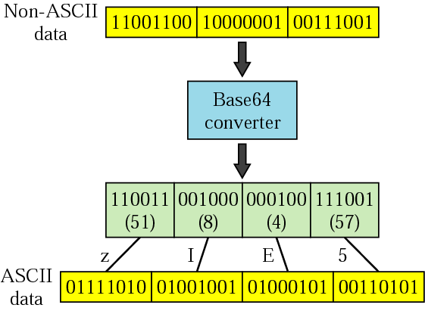
26.1 Electronic Mail → MIME → Header Fields → Content-Transfer-Encoding :
Figure 26. 6 Base64
Base64:
Base64 divides the binary data (made of streams of bits) into 24-bit blocks.
Each block is then divided into four sections, each made of 6-bits as shown in Fig. 26.6 below:
Each 6-bit section is interpreted as one character according to table 26.3 in next slide:

Slide 35
Table 26.3 Base64 encoding table
Value | Code | Value | Code | Value | Code | Value | Code | Value | Code | Value | Code
0 | A | 11 | L | 22 | W | 33 | h | 44 | s | 55 | 3
1 | B | 12 | M | 23 | X | 34 | i | 45 | t | 56 | 4
2 | C | 13 | N | 24 | Y | 35 | j | 46 | u | 57 | 5
3 | D | 14 | O | 25 | Z | 36 | k | 47 | v | 58 | 6
4 | E | 15 | P | 26 | a | 37 | l | 48 | w | 59 | 7
5 | F | 16 | Q | 27 | b | 38 | m | 49 | x | 60 | 8
6 | G | 17 | R | 28 | c | 39 | n | 50 | y | 61 | 9
7 | H | 18 | S | 29 | d | 40 | o | 51 | z | 62 | +
8 | I | 19 | T | 30 | e | 41 | p | 52 | 0 | 63 | /
9 | J | 20 | U | 31 | f | 42 | q | 53 | 1
10 | K | 21 | V | 32 | g | 43 | r | 54 | 2

Slide 36
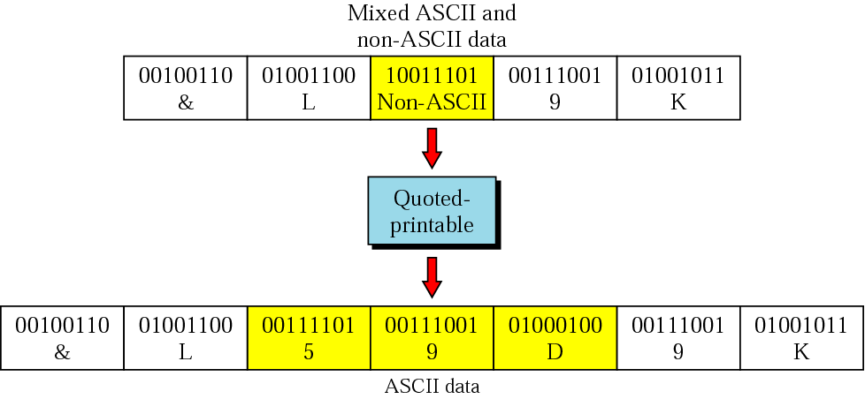
26.1 Electronic Mail → MIME → Header Fields → Content-Transfer-Encoding :
Figure 26.7 Quoted-printable
Quoted-Printable:
Base64 is a redundant encoding scheme; that is, 24 bits becomes four characters and eventually is sent as 32 bits.
We have overhead of 33.3 percent.
If the data consist mostly of ASCII characters with a small non-ASCII portion, we can use Quoted-Printable encoding.
If a character is ASCII, it is sent as three characters.
The first character is the equal sign (=).
The next two characters are the hexadecimal representation of the byte.
Fig. 26.7 below shows an example:

Slide 37
26.1 Electronic Mail → MIME → Header Fields → Content-Id :
This header uniquely identifies the whole message is a multiple-message environment.
Content-Id : id=<content-id>

Slide 38
26.1 Electronic Mail → MIME → Header Fields → Content-Description :
This header field defines whether the body is
      image,
      audio or
      video.
Content-Description : <description>

Slide 39
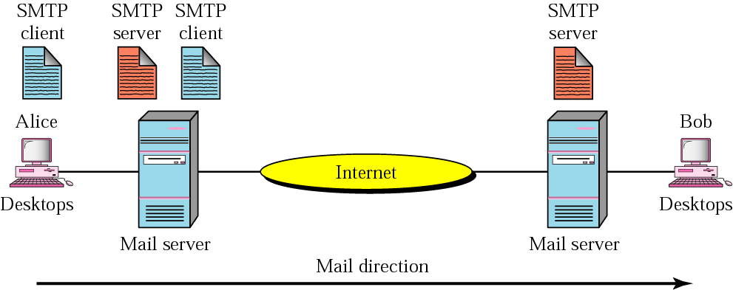
26.1 Electronic Mail → Mail Transfer Agent (MTA) :
Figure 26.8 MTA client and server
The actual mail transfers done through Mail Transfer Agents (MTAs).
To send mail, a system must have a client MTA and
To receive a mail, a system, must have a server MTA.
In Internet, message transfer is done through protocol (and software) named Simple Mail Transfer Protocol (SMTP).
To send a message, we need a client SMTP and a server SMPT.
Fig. 26.8 below Alice is shown sending email to Bob with the SMTP clients and server needed.

Slide 40
26.1 Electronic Mail → Mail Transfer Agent (MTA) :
Note that mail transfer occurs between the two mail servers, one at Alice’s site and the other at Bob’s site.
The mail servers can belong to the ISPs to which Alice and Bob are subscribers or they can belong to companies where Alice and Bob work.

Slide 41
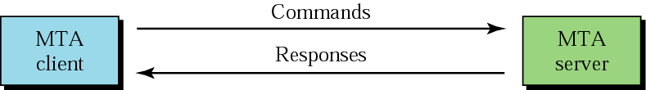
26.1 Electronic Mail → MTA → Commands and Responses :
Figure 26.9 Commands and responses
SMTP uses commands and responses to transfer messages between an MTA client and an MTS server, as shown in Fig. 26.9 below:
Each command or reply is terminated by a two-character (carriage return and line feed) end-of-line token.

Slide 42
26.1 Electronic Mail → MTA → Commands and Responses :
Commands:
Commands are sent fro the client to the server.
A command consists of a keyword followed by zero or more arguments.
SMTP defines 14 commands.
Responses:
Responses are sent from the server to the client.
A response is a three digit code that my be followed by additional texual information.

Slide 43
26.1 Electronic Mail → MTA → Mail Transfer Phases :
The process of transferring a mail message occurs in three phases:
    Connection establishment,
    Message transfer and
    Connection termination.
Connection Establishment:
After a client has made a TCP connection to the well-known port 25, the SMTP server starts the connection phase.
Message Transfer:
After connection has been established between SMTP client and server, a single message between a sender and one or more recipients can be exchanged.
Connection Termination:
After the message is transferred successfully, the client terminates the connection.

Slide 44
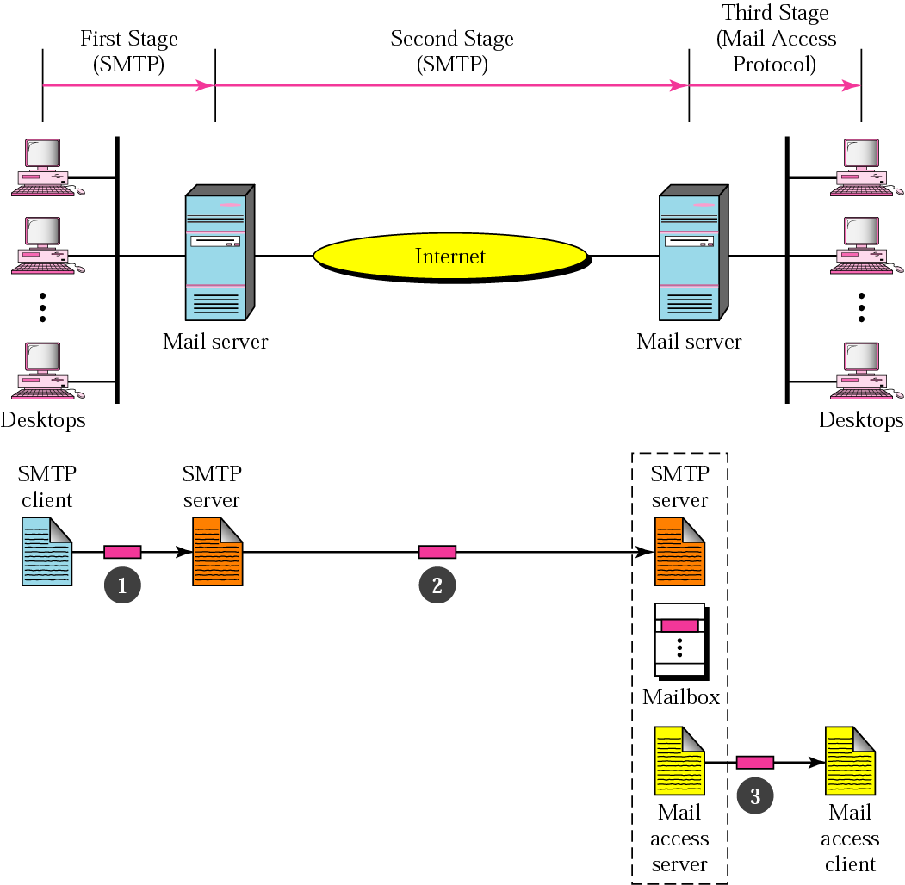
26.1 Electronic Mail → Mail Delivery:
Figure 26.10 Email delivery
The delivery of email from the sender to the receiver consists of three stages as shown in Fig 26.20 below:

Slide 45
26.1 Electronic Mail → Mail Delivery → First Stage:
In the first stage, the email goes from the user agent to the local server.
The mail does not go directly to the remote server because the remote server may not be available at all times.
Therefore, the mail is stored in the local server until it can be sent.
The user agent uses SMTP client software,
and the local server uses SMTP server software.

Slide 46
26.1 Electronic Mail → Mail Delivery → Second Stage:
In second stage, the email relayed by local server, which now acts as the SMTP client, to the remote server, which is the SMTP server in this stage.
The email is delivered to the remote server, not to the remote user agent.
The reason is that SMTP messages must be received by a server that is always running since mail can arrive at any time.
However, people often turnoff there computers at the end of the day, and those with laptops or mobile computers do not normally have them all the time.
So usually an organization (or an ISP) assigns a computer to be the email server and run the SMTP server program.
The email is received by this mail server and stored in the mailboxes of the user for later retrieval.

Slide 47
26.1 Electronic Mail → Mail Delivery → Third Stage:
In third stage, the remote user agent uses a Mail Access Protocol such as POP3 or IMAP4 (both coming up) to access the mailbox and obtain the mail.

Slide 48
26.1 Electronic Mail → Mail Access Protocols:
The first and second stages of mail delivery use SMTP.
However, SMTP is not involved in the third stage.
Because SMPT is a push protocol: it pushes messages from sender to receiver even if the receiver does not want it.
The operation of SMTP starts with sender, not the receiver.
On the other hand, the third stage needs a pull protocol: the operation must start with the recipient.
The mail must stay in the mail server mailbox until the recipient retrieves it.
The third stage uses a Mail Access Protocol.
Currently two mail access protocols are available:
    Post Office Protocol, version 3. (POP3) and
    Internet Mail Access Protocol, version 4 (IMAP4).

Slide 49
26.1 Electronic Mail → Mail Access Protocols → POP3:
  Post Office Protocol, version 3. (POP3) is simple, but is limited in functionality.
  The Clint POP3 software is installed on the recipient computer.
  The server POP3 software is installed on the mail server.
  Mail access starts with the client when the user needs to download email from the mailbox on the mail server.
  The client (user agent) opens a connection with the server TCP port 110.
  It then sends its user name and password to access mailbox.
  The user can then list and retrieves the mail messages, one by one.

Slide 50
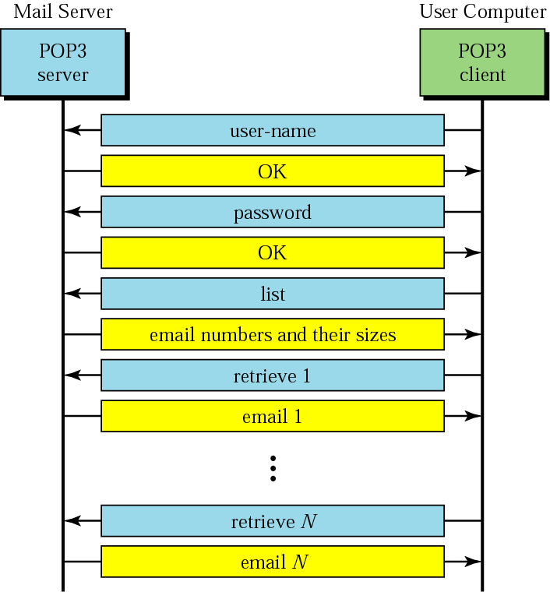
26.1 Electronic Mail → Mail Access Protocols → POP3:
Figure 26.11 POP3
  Fig. 26.11 below shows an example of downloading using POP3.

Slide 51
26.1 Electronic Mail → Mail Access Protocols → POP3:
  POP3 has two modes:
      The delete mode and
      The keep mode.
  In the delete mode, the mail is deleted from the mailbox after each retrieval.
    It is used when the user is working at his or her permanent computer and can save and organize the received mail after reading or replying.
  In the keep mode, the mail remains in the mailbox after retrieval.
    It is used when the user accesses mail away from the primary computer (e.g., a laptop).
    The mail is read but kept in the system for later retrieval and organizing.

Slide 52
26.1 Electronic Mail → Mail Access Protocols → POP3 (drawbacks):
  POP3 assumes that each time a client accesses the server, the whole mailbox will be cleared out (transferred).
  This is not continent when people access their mailboxes from different clients (at home, at work, on a trip at a hotel etc).
  POP 3 deficient in several ways it does not allow the user to organize mail on the server; the user cannot have different folders on the server.
  User can only create folders on his/her own computer.
  In addition POP3does not allow the user to partially check the contents of the mail before downloading.

Slide 53
26.1 Electronic Mail → Mail Access Protocols → IMAP4:
  Internet Mail Access Protocol, version4 (IMAP4) is another mail access protocol similar to POP3.
  IMAP4 has more features, more powerful and more complex.
  IMAP provides the following extra functions:
  A user can check the mail header prior to downloading.
  A user can search the contents of the mail for a specific string of characters prior to downloading.
  A user can partially download email.
    This is specially useful if bandwidth is limited and the email contains multimedia with high bandwidth requirement,
  A user can create, delete or rename mailbox on the mail server.
  A user can create hierarchy of mailboxes in a folder for email storage.

Slide 54
26.1 Electronic Mail → Web-Based Mail :
Email is such a common application that some websites today provide this service to anyone who accesses the site.
The common sites are Hotmail and Yahoo.
The ides is very simple.
  Mail transfer from Alice’s browser to her mail server is done through HTTP.
  The transfer of message from sending mail server to the receiving mail server is still through SMTP.
  Finally, the message from the receiving server (the web server) to Bob’s browser is done through HTTP.
The last phase is very interesting.
Instead of P{OP3 or IMAP4, HTTP is normally used.
When Bob needs to retrieve his emails, he sends a message to the website (e.g, Yahoo).
The website sends a form to be filled in y Bob, which includes the log-in name ad password.
If the log-in name and password match, the email is transferred from web-server to Bob’s browser in HTML format.

Slide 55
26.2 File Transfer
Connections
Communication
File Transfer
User Interface
Anonymous FTP

Slide 56
26.2 File Transfer Protocol (the Reason of existence…) :
File Transfer Protocol (FTP) is the standard mechanism provided by the Internet for copying a file from one host to another.
Transferring files from one computer to another is one of the most common tasks expected from a networking or inter-networking environment.
Although transferring files from one system to another seems simple and straight forward, but there are some problems:
  What if the two systems are using different file name conventions?
  What if two systems have different ways to represent text and data?
  What if two systems have different directory structure?
All these and other problems are solved by FTP in a very simple and elegant manner.

Slide 57
26.2 File Transfer Protocol (explanation…) :
FTP differs from other client-server applications in that it establishes two connections between the client and the server.
    One connection is used for data transfer,
    The other is for control information (commands and responses).
Separation of commands and data transfer makes FTP more efficient.
The control connection uses very simple rules of communication.
  We need to transfer only one line of command or a line of response art a time.
The data connection, needs more complex rules due to variety of data types transferred.
FTP uses two well-known TCP ports:
    Port 20: used for data connection,
    Port 21: used for control connection.

Slide 58
Note:
FTP uses the services of TCP. It needs two TCP connections. The well-known port 21 is used for the control connection, and the well-known port 20 is used for the data connection.

Slide 59
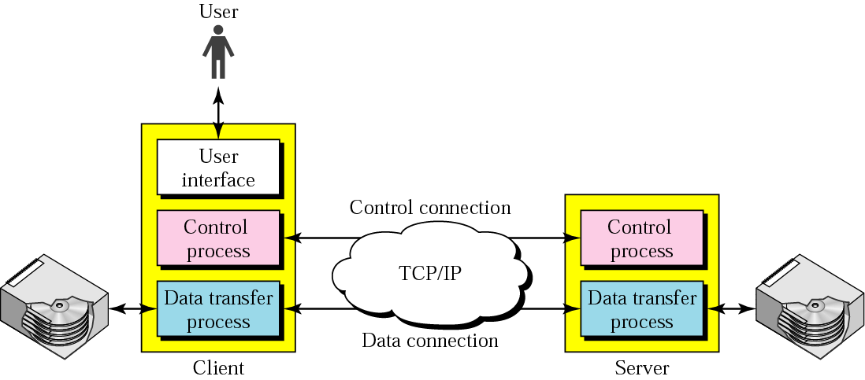
26.2 File Transfer Protocol (Structure…) :
Figure 26.12 FTP
Fig 26.12 below shows the basic model of FTP.
The client has three components:
      User Interface,
      Client Control Process and
      Client data transfer process.
The server has two components:
      Server control process and
      Server data transfer process.
The control connection is made between the control processes.
The data connection is made between the data transfer processes.

Slide 60
26.2 File Transfer Protocol (Working…) :
Figure 26.12 FTP
The control connection is maintained during the entire interactive FTP session.
The data connection is opened and then closed after each file is transferred.
  It opens each time commands that involve transferring files are used,
  And it closes when the file is transferred.
We can say that, when FTP session starts,
  The control connection opens,
  While the control connection is open, the data connection can be opened and closed multiple ties if several files are transferred.

Slide 61
26.2 FTP → Connections :
The two FTP connections:
      Control connection and
      Data connection,
Use different strategies and different port numbers.
Control Connection:
The control connection uses well-known port 21 and it is created in the same way as other application programs described so for.
The connection remains open during the entire process.
The service type used by the IP is minimize delay,
  Because there is an interactive connection a user (human) and a server.
The user types commands and expects to receive responses without significant delay.
Data connection:
The data connection uses the well-known port 21 at the receiver site.
The data connection is opened when data are ready to transfer.
It is closed when it is not needed.
A data connection may be opened and closed several times during session:
  The control connection is opened and closed once.
The service type used by IP is maximize throughput.

Slide 62
26.2 FTP → Communication :
FTP client and server, which run on different computers, must communicate with each other.
The two computers may use
    Different operation systems,
    Different character sets,
    Different file structures and
    Different file formats.
FTP must make this heterogeneity compatible.
FTP has two different approaches:
    Communication over Control Connection and
    Communication over Data Connection.

Slide 63
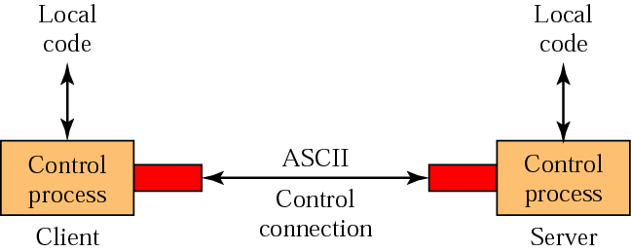
26.2 FTP → Communication → Communication Over Control Connection :
Figure 26.13 Using the control connection
FTP uses the same approach as SMTP to communicate across the control connection.
It uses the ASCII character set as shown in Fig. 26.13 below:
Communication is achieved through commands and responses.
Because one command (response ) is sent at a time so the simple method is sufficient .
Each command or response is a short line, so we need not worry about the file format or file structure.
Each line is terminated with two characters Carriage return (enter key) and Line feed end-of-line token.

Slide 64
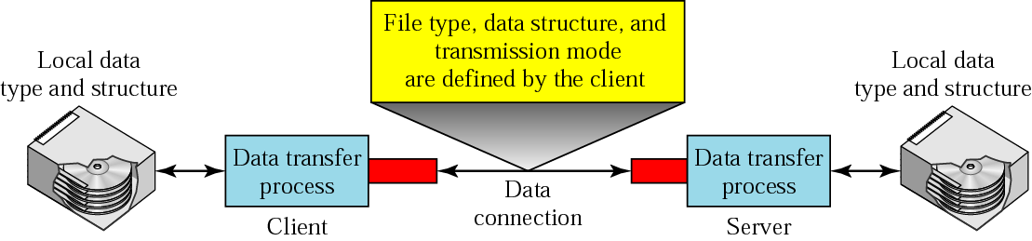
26.2 FTP → Communication → Communication Over Data Connection :
Figure 26.14 Using the data connection
The purpose and implementation of the data connection are different of the control connection.
We want to transfer files through the data connection.
    The client must define the
    Type of file to be transferred,
    The structure of data and
    The transmission mode.
Before sending the file through the data connection, we prepare for transmission through control connection.,
The heterogeneity problem is solved by defining three attributes of communication:
    File type
    Data structure and
    Transmission mode.
Fig. 26.14 below shows this concept:

Slide 65
26.2 FTP → Communication → File Type :
FTP can transfer one of the following file types across the data connection:
ASCII File:
This is default format for transferring text files.
Each character is encoded using ASCII.
The sender transforms the file from its own representation to ASCII characters, and the receiver transforms the ASCII characters to its own representation.
EBCDIC File:
The file can be transferred using EBCDIC encoding if one or both ends of the connection use EBCDID encoding (used in IBM computers).
Image File:
This is the default format for transferring binary files.
The file is sent as continuous streams of bits without ant interuption or encoding.
The is mostly used to transfer binary files such as compiled programs or images encoded as 0s and 1s.
EBCDIC: E(xtended) B(inary) C(oded) D(ecimal) I(nterchange) C(ode).]
A standard code that uses 8 bits to represent each of up to 256 alphanumeric characters.

Slide 66
26.2 FTP → Communication → Data Structures :
FTP can transfer a file across the data connection by using one of the following interpretations about the structure of the data:
File Structure (default):
The file has no structure.
It is continuous stream of bytes.
Record Structure:
The file is divided into records (or structs in C).
This can be used only with text files.
Page Structure:
The file is divided into pages. With each page having a page number and a page header.
The pages can be
      Stored or
      Accessed randomly or
      Sequentially.

Slide 67
26.2 FTP → Communication → Transmission Mode :
FTP can transfer a file across the data connection by using one of the following three transmission modes:
Stream Mode:
This is the default mode.
Data are delivered from FTP to TCP as a continuous stream of bytes.
TCP is responsible for chopping data into segments of appropriate size.
If the data are simply a stream of bytes (file structure):
  No end-of-file is needed.
  End-of-file in this case is closing of the data connection by the sender.
If the data are divided into records (record structure):
  Each record will have 1-byte end-of-record (EOR) character.
  And the end of the file will have a 1-byte end-of-file (EOF) character.
Block Mode:
Data can be delivered from FTP to TCP in blocks.
In this case, each block is preceded by a 3-byte header.
  The first header is called the block descriptive,
  The next two headers define the size of he block in bytes.

Slide 68
26.2 FTP → Communication → Transmission Mode :
Compressed Mode:
If the file is big, the data can be compressed.
The compression method normally used in run-length encoding.
  In this method, consecutive appearances of a data unit are replaced by one occurrence and the number o repetitions.
In a text file this is usually spaces (blanks).
In a binary file, null characters are usually compressed.

Slide 69
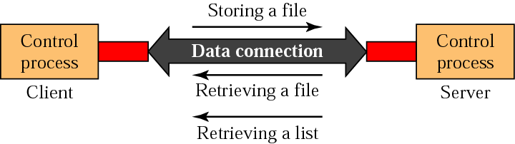
26.2 FTP → File Transfer :
Figure 26.15 File transfer
File transfer occurs over the data connection under the control of the commands sent over the control connection.
However, remember that file transfer in FTP means one of three things as shown in Fig. 26.15 below:
A file is to be copied from the server to the client.
  This is called file retrieving a file.
A file is to copied from the client to the server.
  This is called storing a file.
A list of directory of file names is to be sent from the server to the client.
  FTP treats a list of directory or file name as a file.
  It is sent over the data connection.

Slide 70
Example 1
Figure 26.16 (next slide) shows an example of how a file is stored.
The control connection is created, and several control commands and responses are exchanged.
Data are transferred record by record.
A few commands and responses are exchanged to close the connection.

Slide 71
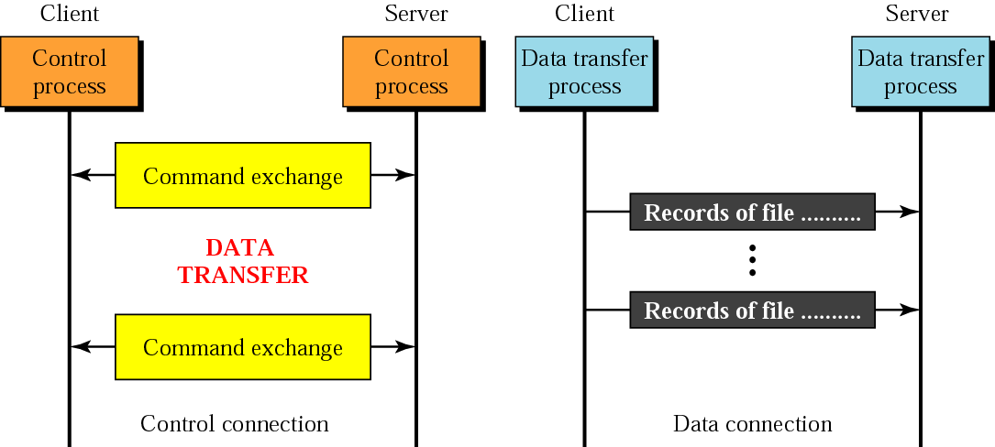
Figure 26.16 Example 1
The control connection is created, and several control commands and responses are exchanges.
Data are transferred record by record.
A few commands and responses are exchanged to close the connection.

Slide 72
26.2 FTP → Communication → User Interface :
Most operating System provide a user interface to access the services of FTP.
The interface prompts the user for the appropriate input.
After the user types a line, the FTP interface reads the line and changes it to the corresponding FTP command.
Table 26.4 in next slide shows the interface commands provided in UNIX FTP.
Some of the commands can be abbreviated as long as there is no ambiguity.

Slide 73
Table 26.4 List of FTP commands in UNIX
Commands
!, $, account, append, ascii, bell, binary, bye, case, cd, cdup, close, cr, delete, debug, dir, discount, form, get, glob, hash, help, lcd, ls, macdef, mdelete, mdir, mget, mkdir, mls, mode, mput, nmap, ntrans, open, prompt, proxy, sendport, put, pwd, quit, quote, recv, remotehelp, rename, reset, rmdir, runique, send, status, struct, sunique, tenex, trace, type, user, verbose,?

Slide 74
Example 2
We show some of the user interface commands that accomplish the same task as in Example 1. The user input is shown in boldface. As shown below, some of the commands are provided automatically by the interface. The user receives a prompt and provides only the arguments.
$ ftp challenger.atc.fhda.edu
Connected to challenger.atc.fhda.edu
220 Server ready
Name: forouzan
Password: xxxxxxx
ftp > ls /usr/user/report
200 OK
150 Opening ASCII mode
...........
...........
226 transfer complete
ftp > close
221 Goodbye
ftp > quit

Slide 75
26.2 FTP → Communication → Anonymous FTP :
To use FTP, a user needs an account (user name) and a password on the remote server.
Some sites have a set of files available for public access.
To access these files, a user does not need to have an account or password.
Instead, the user can use anonymous as the user name and guest as the password.
User access to the system is very limited.
Some sites allow anonymous users only a subset of commands.
E.g., most sites allow the user to copy some files, but do not allow navigate through directories.

Slide 76
Example 3
We show an example of using anonymous FTP. We connect to internic.net, where we assume there are some public data available.
$ ftp internic.net
Connected to internic.net
220 Server ready
Name: anonymous
331 Guest login OK, send "guest" as password
Password: guest
ftp > pwd
257 '/' is current directory
ftp > ls
200 OK
150 Opening ASCII mode
bin
...
ftp > close
221 Goodbye
ftp > quit

